Slide 1

Formalar bilan ishlash

Slide 2

Reja:
<input> typelari
<textarea> tegi
<input> va <label> ni ulash usullari

Slide 3

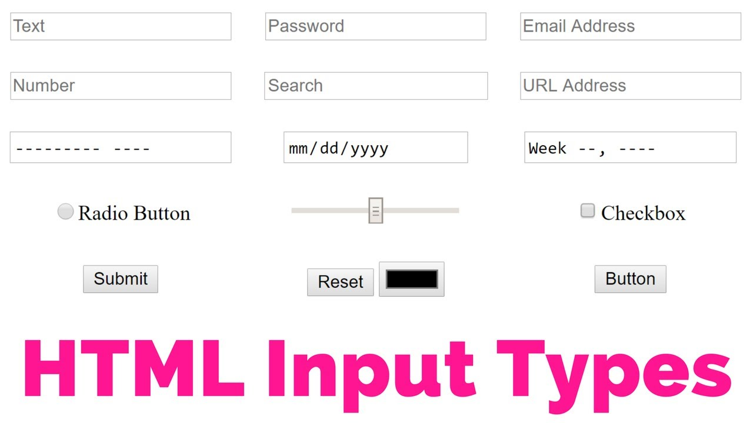

Slide 4
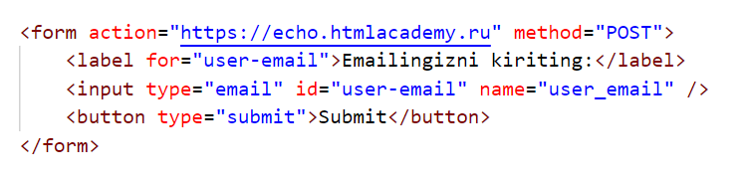
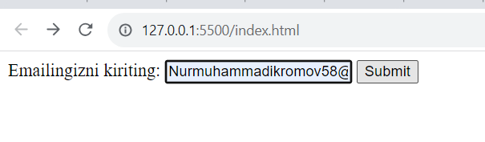
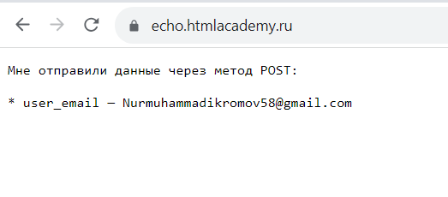
<input type = “email” />

Slide 5
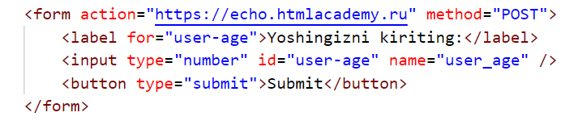
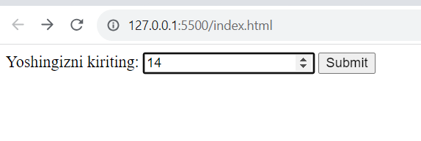
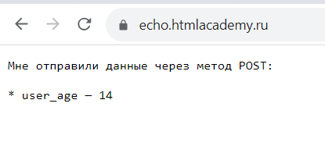
<input type = “number” />

Slide 6
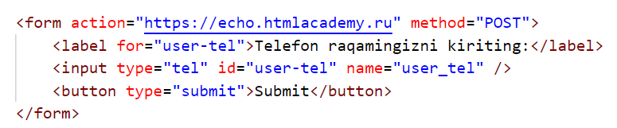
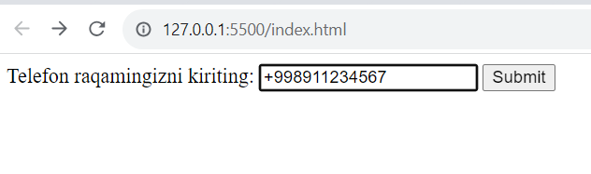
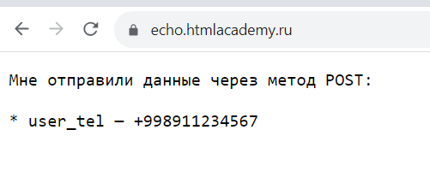
<input type = “tel” />

Slide 7
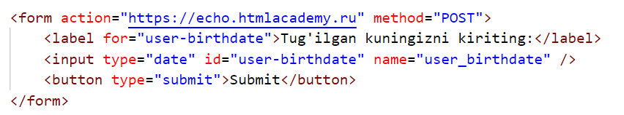
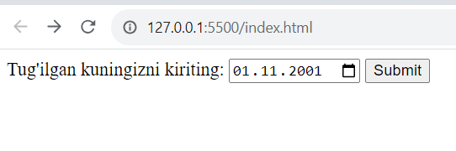
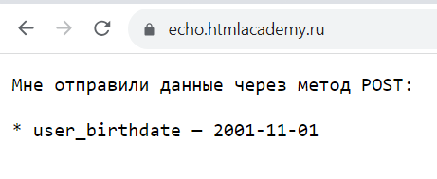
<input type = “date” />

Slide 8
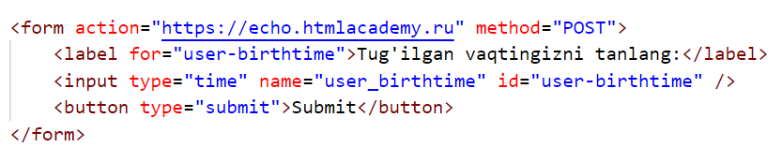
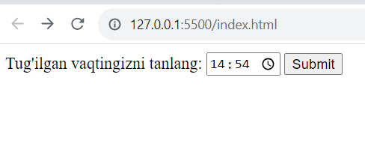
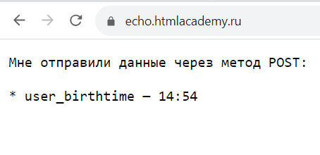
<input type = “time” />

Slide 9
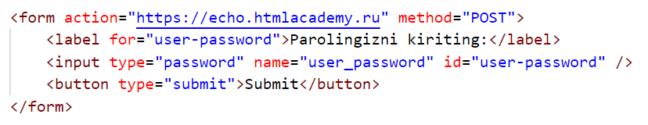
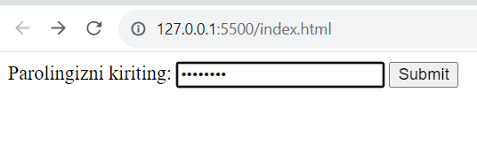
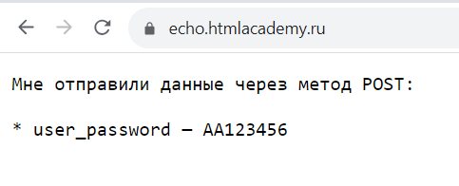
<input type = “password” />

Slide 10
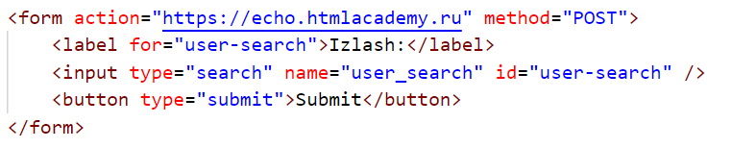
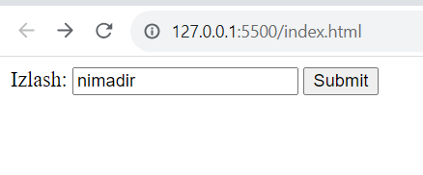
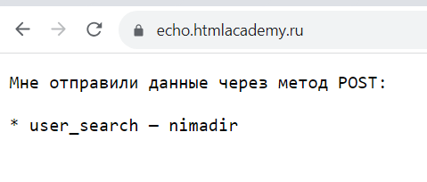
<input type = “search” />

Slide 11
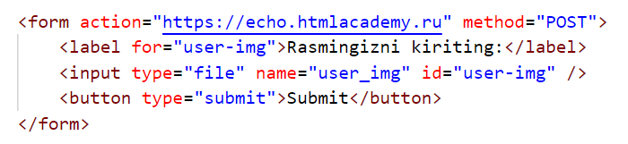
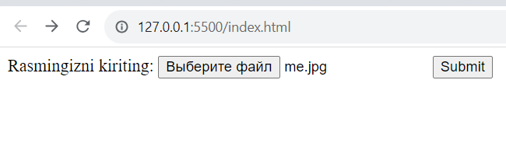
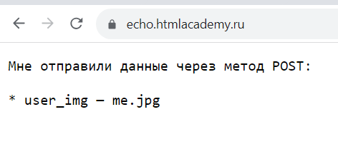
<input type = “file” />

Slide 12
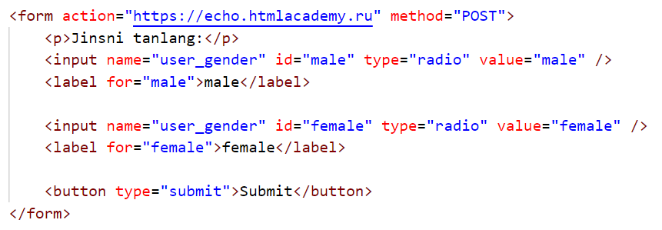
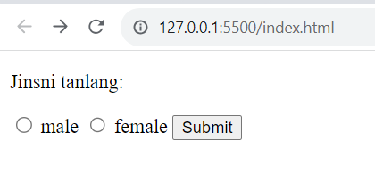
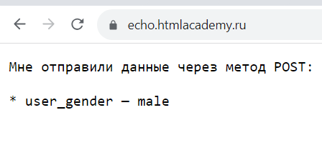
<input type = “radio” />

Slide 13
<input type = “file” />

Slide 14
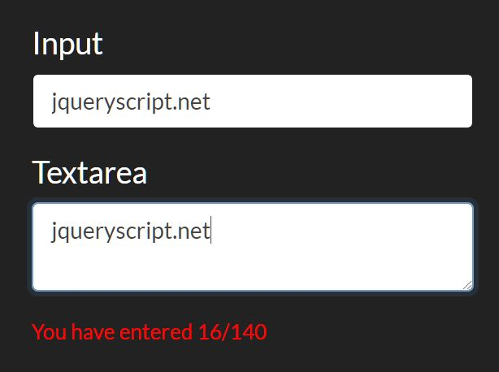
<textarea>
Ko’proq text yozish uchun bizga <input> kichkinalik qilishi mumkin. Bunday hollarda <textarea> tegidan foydalanamiz

Slide 15
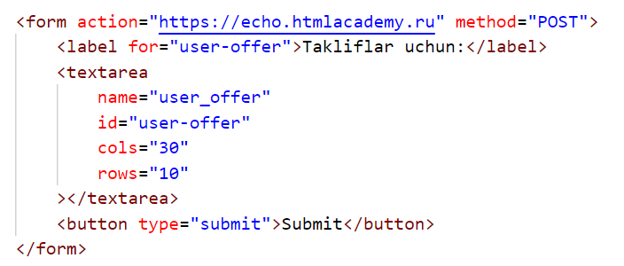
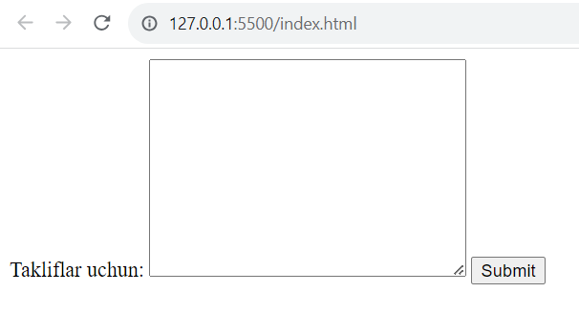
<textarea>

Slide 16
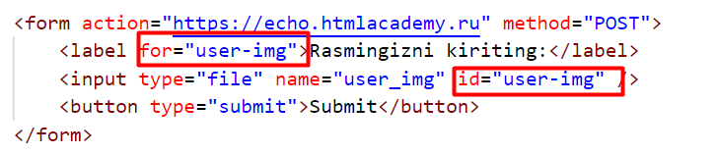
“for” va “id”
<label> ning “for” atributiga va <input>ning “id” atributiga bir xil qiymat berish orqali

Slide 17
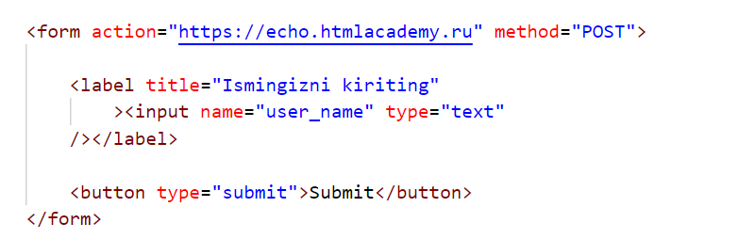
<label> <input /> </label>
<label> ichiga <input>ni solib qo’yish orqali

Slide 18
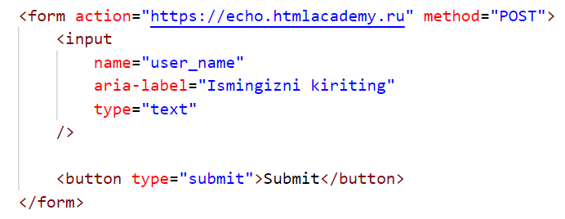
<label>ni yashirib ketish
<input>ning “aria-label” atributidan foydalanib, <label>ni yashirib ketish mumkin.

Slide 19
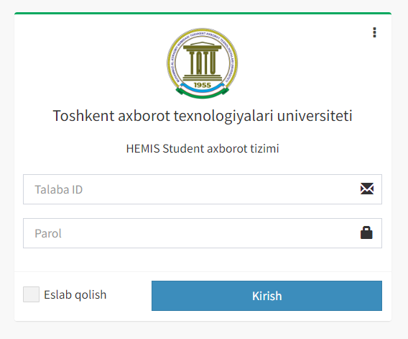
placeholder
<label>dan foydalanmaganimizda, <input>ga qanday ma’lumot kiritishimiz kerakligini bildirish uchun placeholderdan foydalanamiz

Slide 20
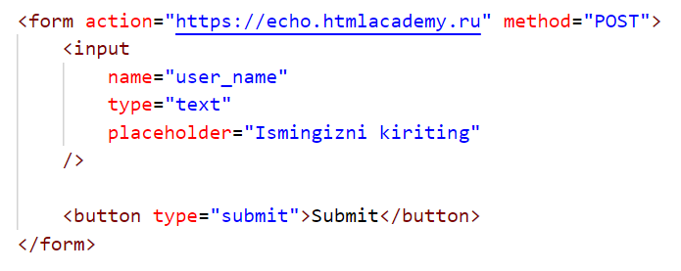
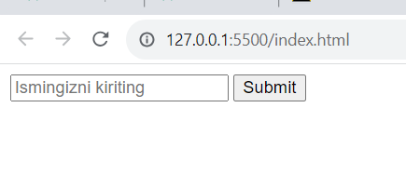
placeholder

Slide 21
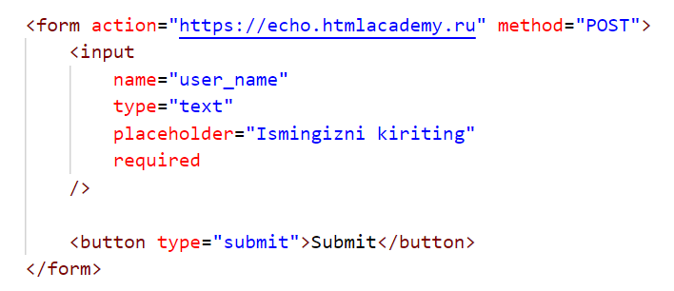
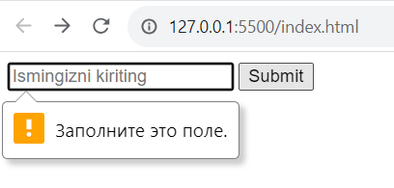
“required” atributi
“required” atributi <input> ichiga ma’lumot kiritish qat’iyligini belgilaydi.

Slide 22

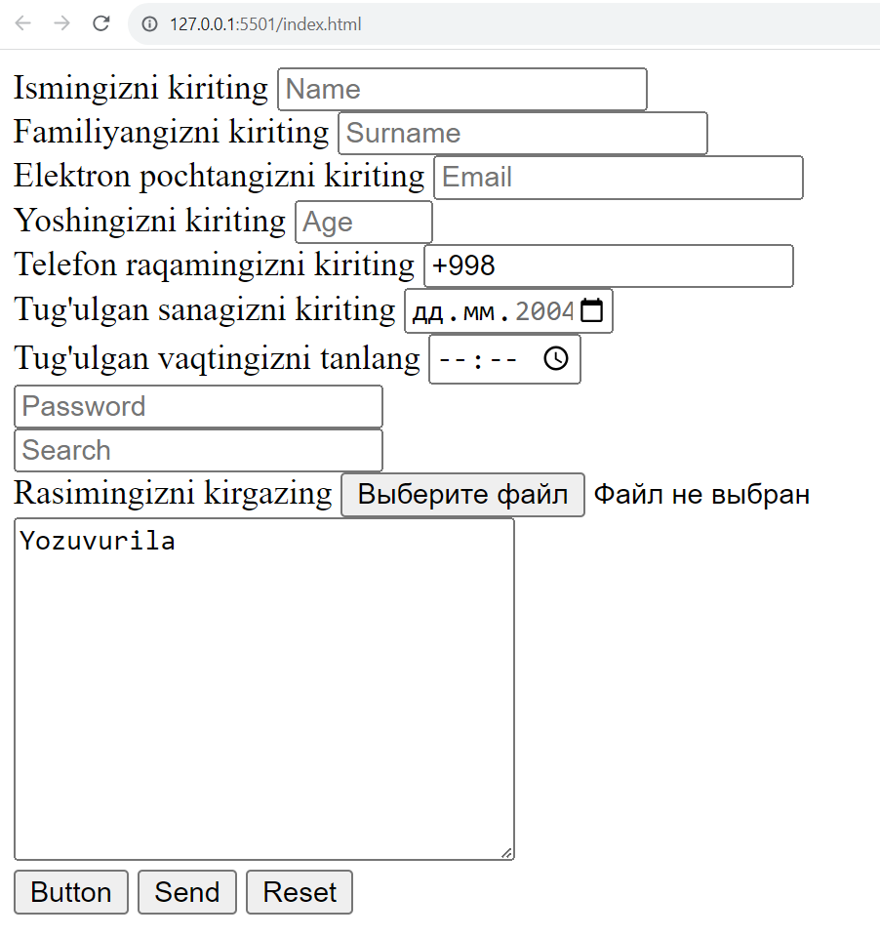

Slide 23


